Slide 1


TaskXpert - A Unified AI-Powered Agent for Smart Emails, Web Extraction, and Data Visualization
Team Member 1:Harsavardhini R (221801016)
Team Member 2:Kaviya S (221801024)
Team Member 3:Monisha M (221801034)
MENTOR : Dr.S.Suresh Kumar

Slide 2
OBJECTIVE
To develop an all-in-one web platform that simplifies common tasks like email creation, data cleaning, and web scraping.
To reduce manual effort and save time by automating repetitive activities using AI and intelligent logic.
To ensure user-friendly interaction with a clean interface that makes the tool accessible to both technical and non-technical users.
To provide secure processing and handling of user data, with a focus on data privacy and confidentiality.
To enable future extensibility by designing the system to easily incorporate additional productivity features.

Slide 3
ABSTRACT
TaskXpert is an AI-powered productivity platform that integrates email generation, web scraping, and CSV data cleaning into a unified web interface. Leveraging the Mistral 7B Instruct model, the system enables users to compose context-aware emails from natural language prompts with manual editing and direct sending capabilities. The platform also supports web scraping to extract useful links from websites and CSV data cleaning using statistical methods, followed by visualizations for insight generation. Built using the MERN stack, TaskXpert offers a secure, scalable, and interactive solution for streamlining digital workflows.

Slide 4
PROPOSED SOLUTION
Multi-Feature Productivity Platform:
Combines email automation, CSV data cleaning, and web scraping in a single web-based tool to streamline daily tasks.
AI-Powered Email Generation:
Uses the Mistral 7B Instruct model to generate context-aware, professional emails based on user prompts.
Smart Data Cleaning Module:
Automatically handles missing values in uploaded CSV files using mean, median, or mode, improving data quality.
Web Scraping to CSV Converter:
Extracts all accessible links from a given website and converts them into a downloadable CSV file with link metadata.

Slide 5
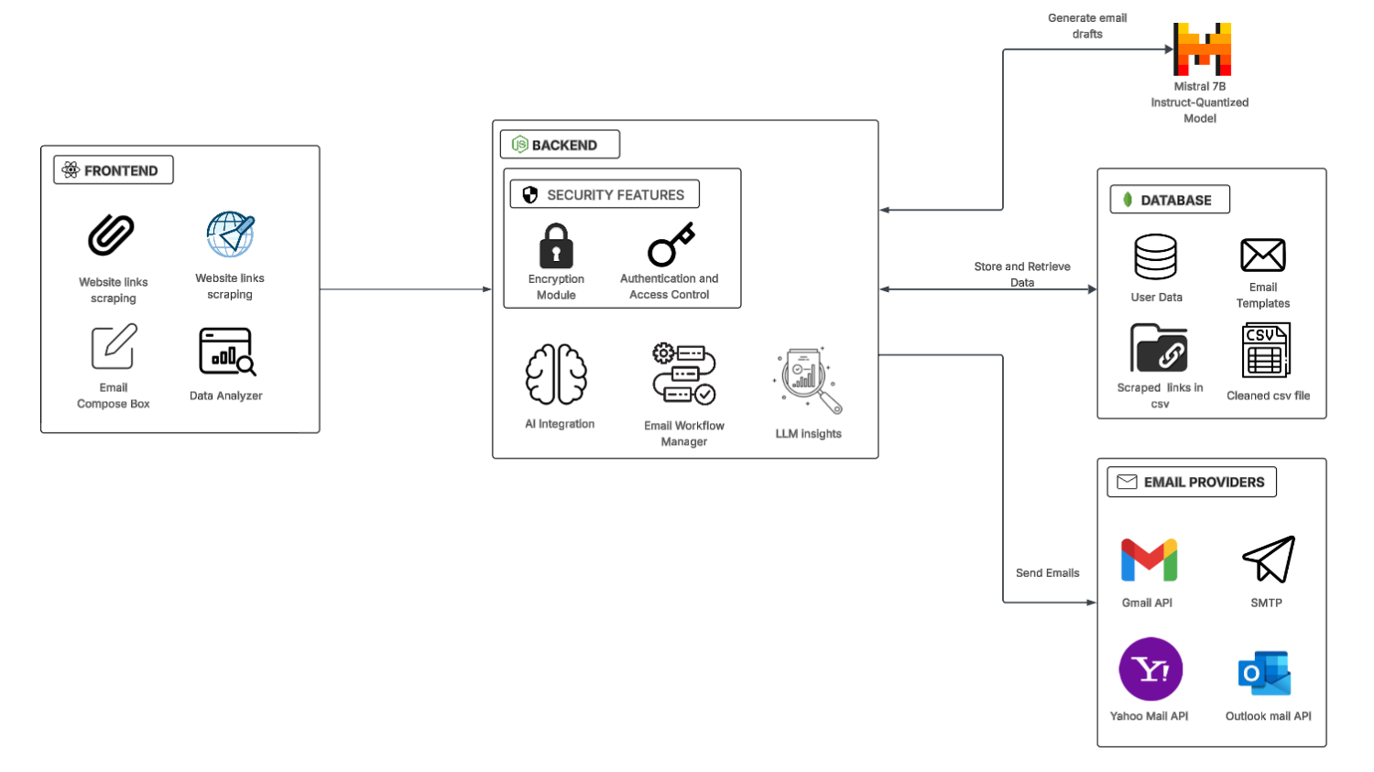
SYSTEM ARCHITECTURE

Slide 6
TECHNOLOGY USED
React.js – Used to build a dynamic and responsive frontend interface.
Node.js & Express.js – Handle backend logic, routing, and API integrations.
MongoDB – Stores user data, email history, and task configurations.
Mistral 7B Instruct – Powers AI-generated email content through natural language prompts.
SMTP & Nodemailer – Enable secure email sending across major providers.
Axios & Cheerio – Perform web scraping to extract hyperlinks from web pages.
ml-stat & ChartJSNodeCanvas– Clean CSV data and generate visual insights through charts.

Slide 7
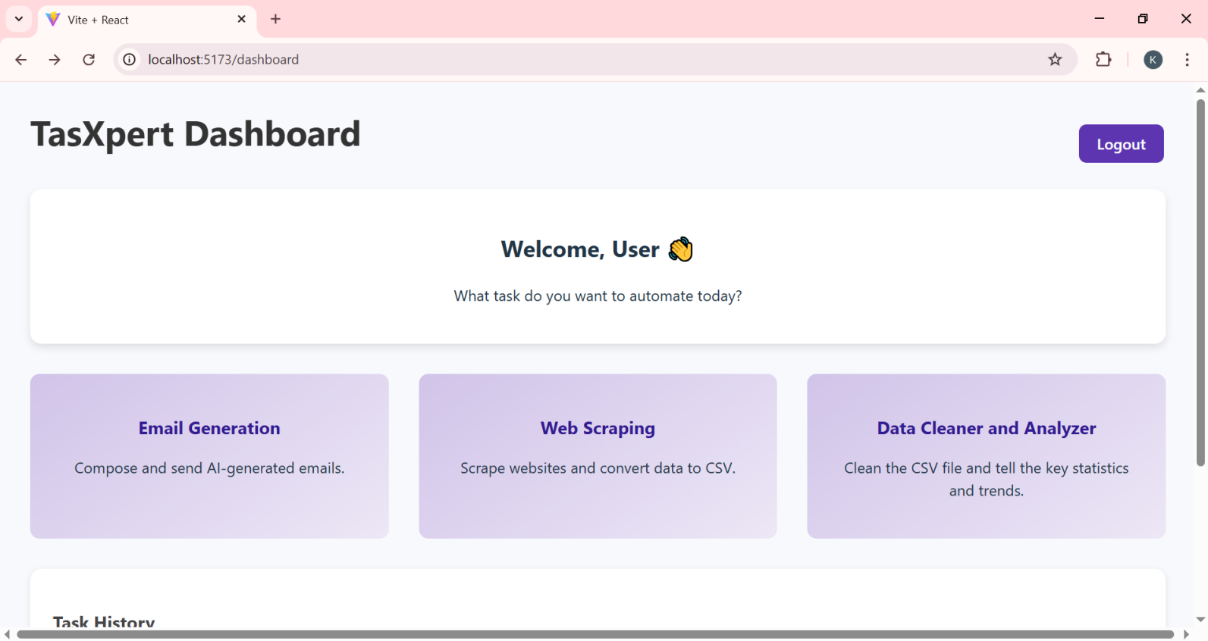
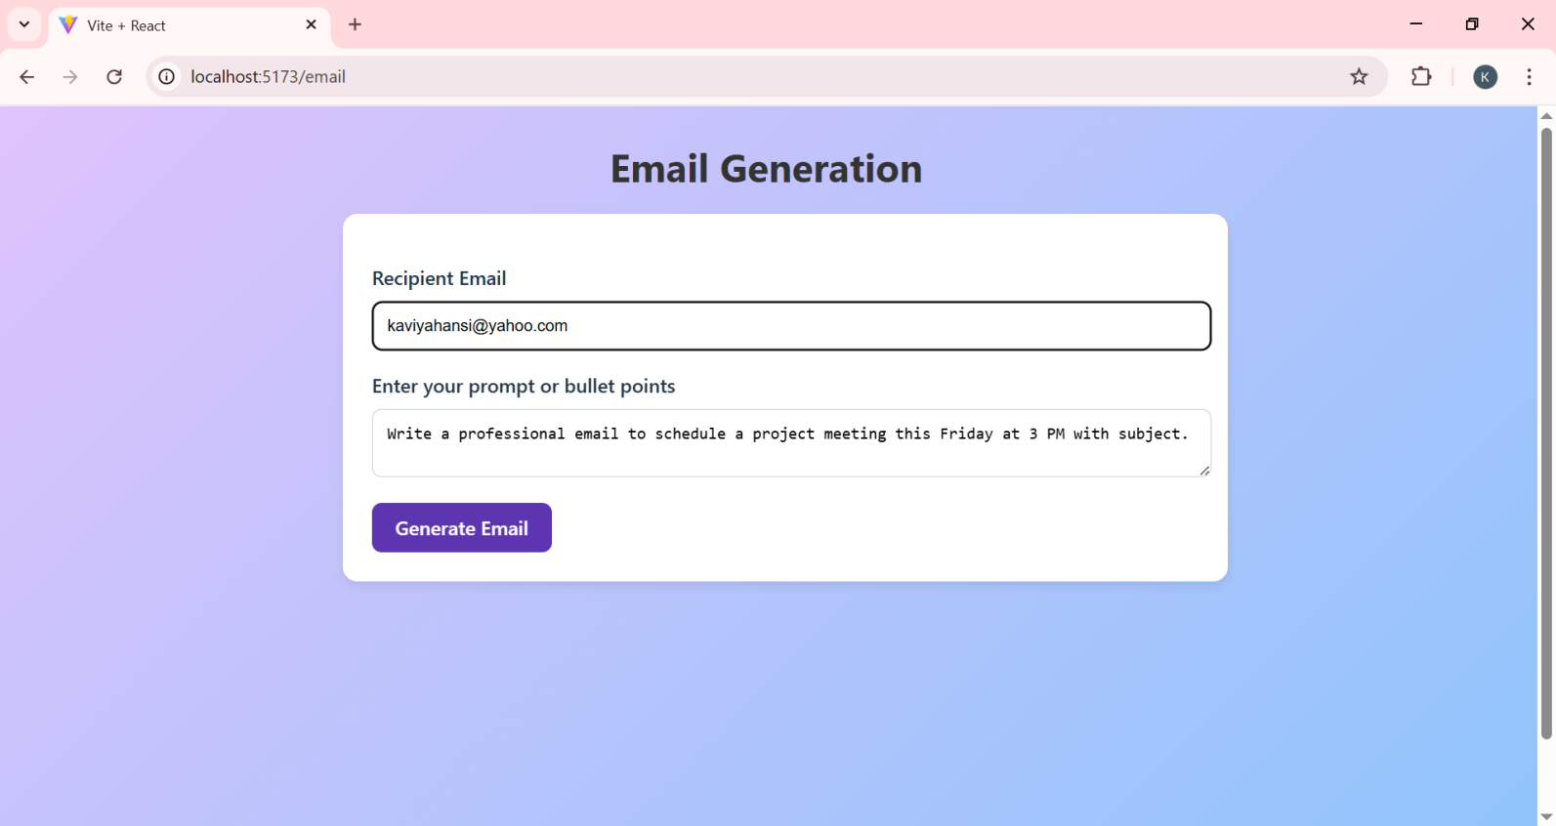
SOLUTION

Slide 8
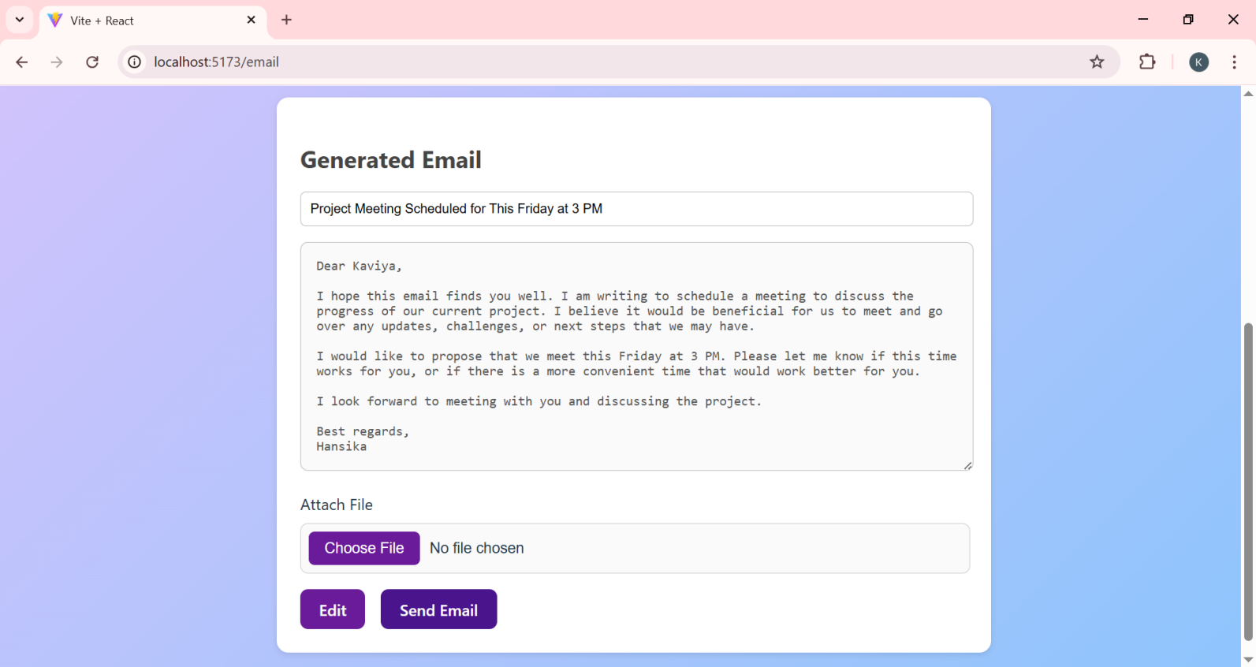
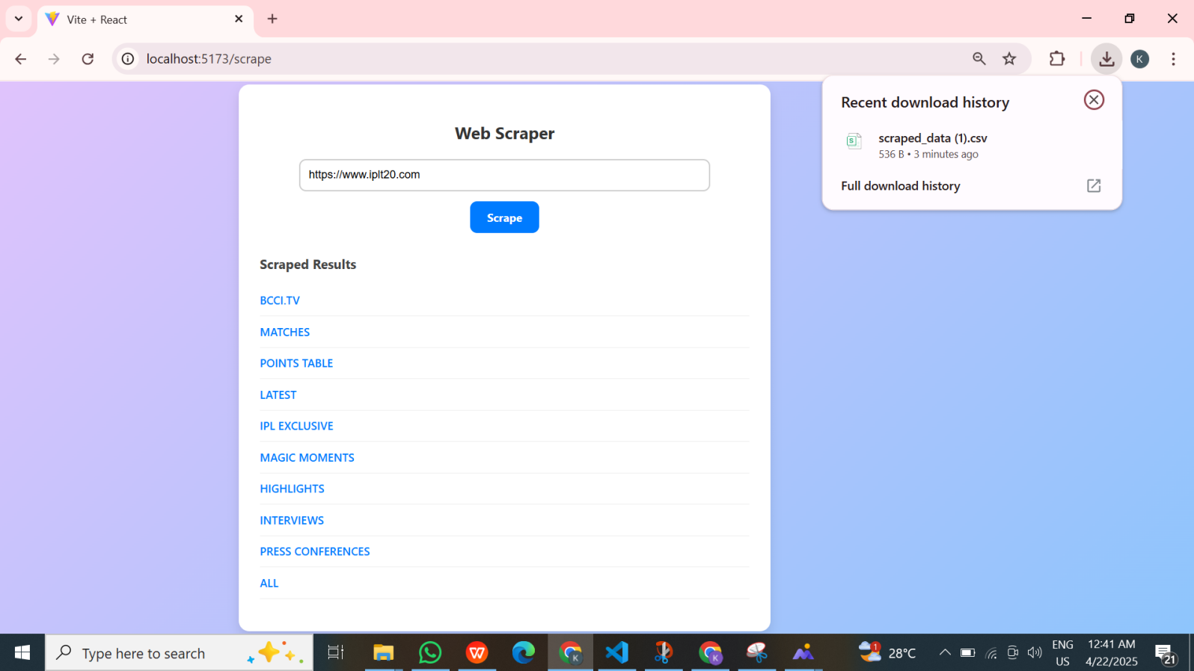
SOLUTION

Slide 9
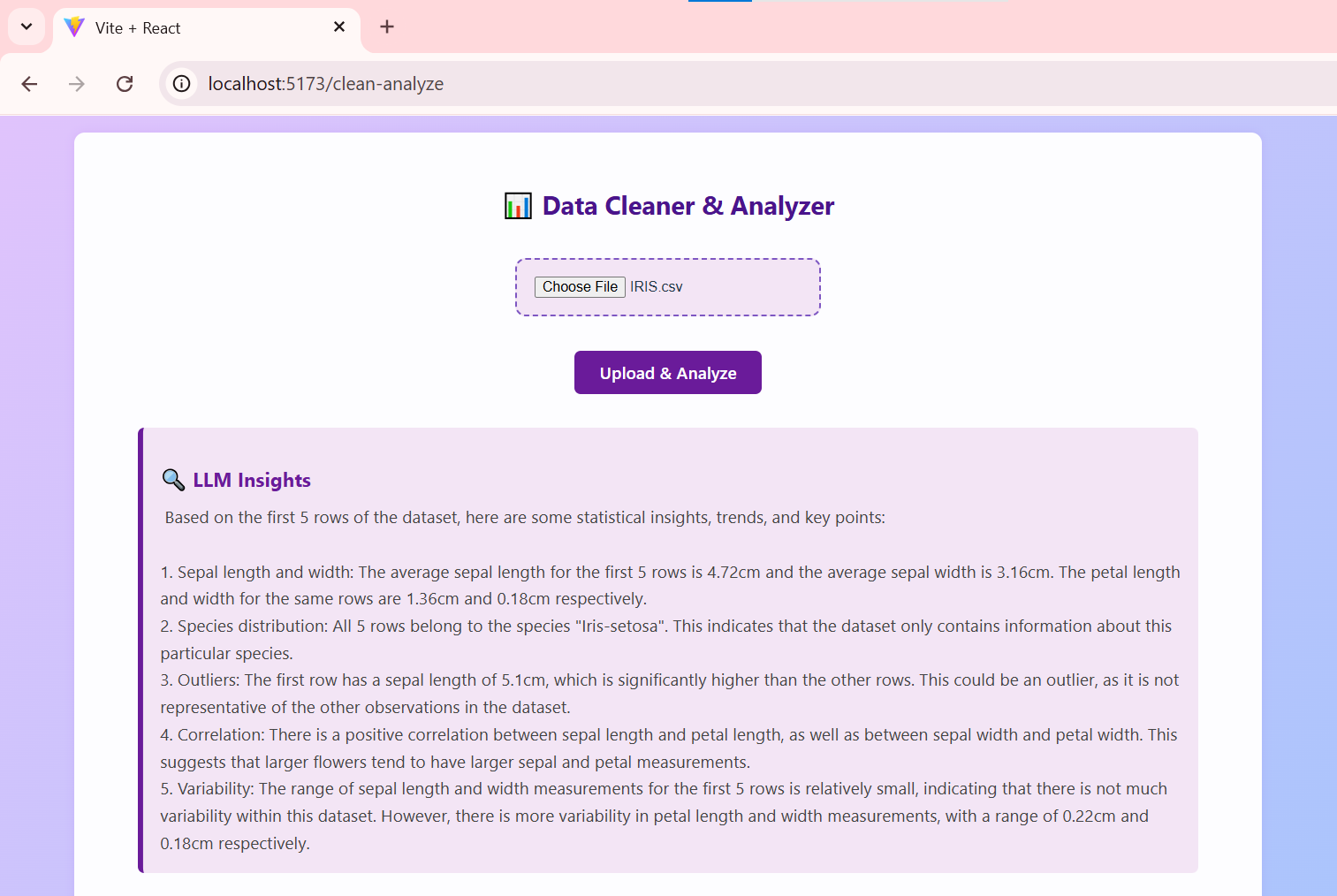
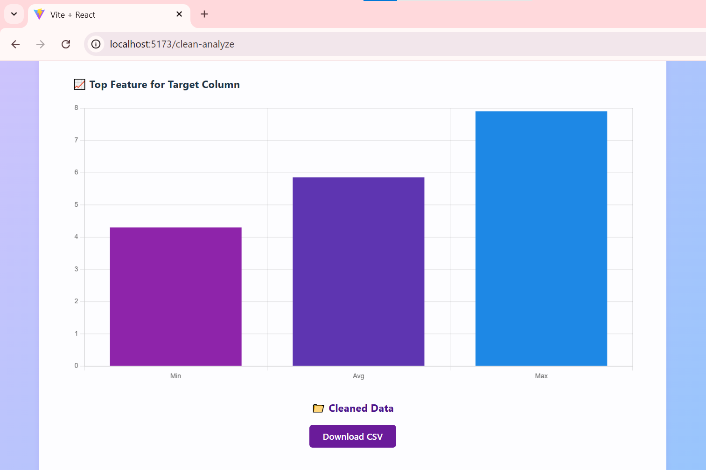
SOLUTION

Slide 10
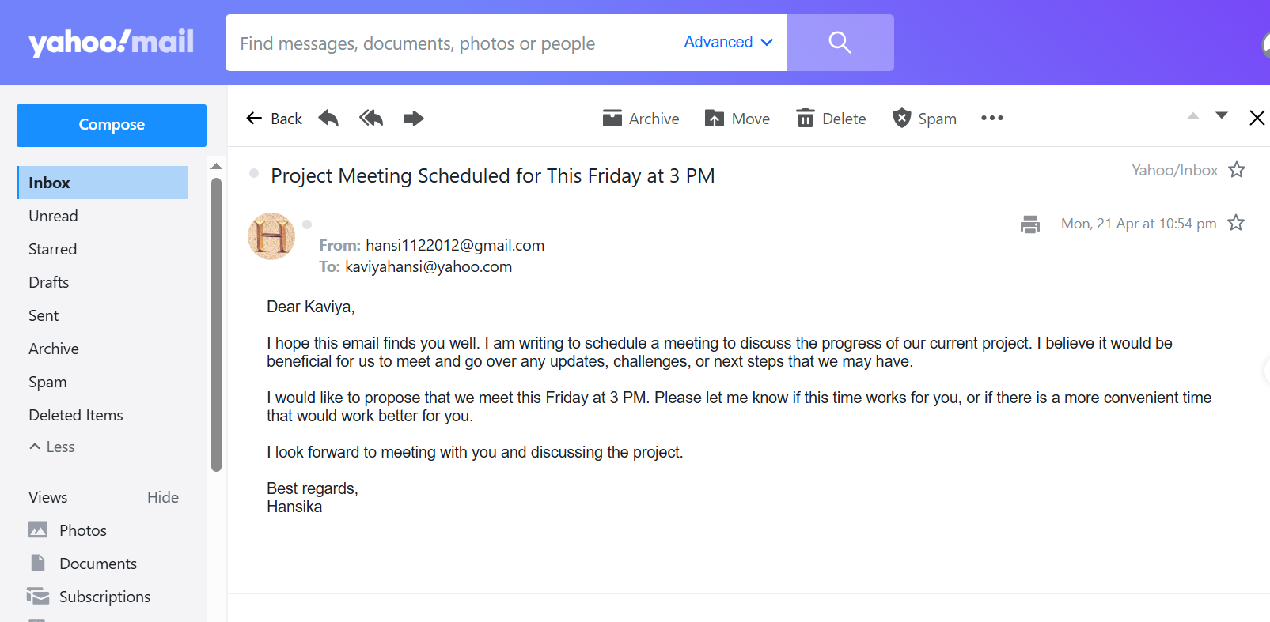
OUTPUTS

Slide 11
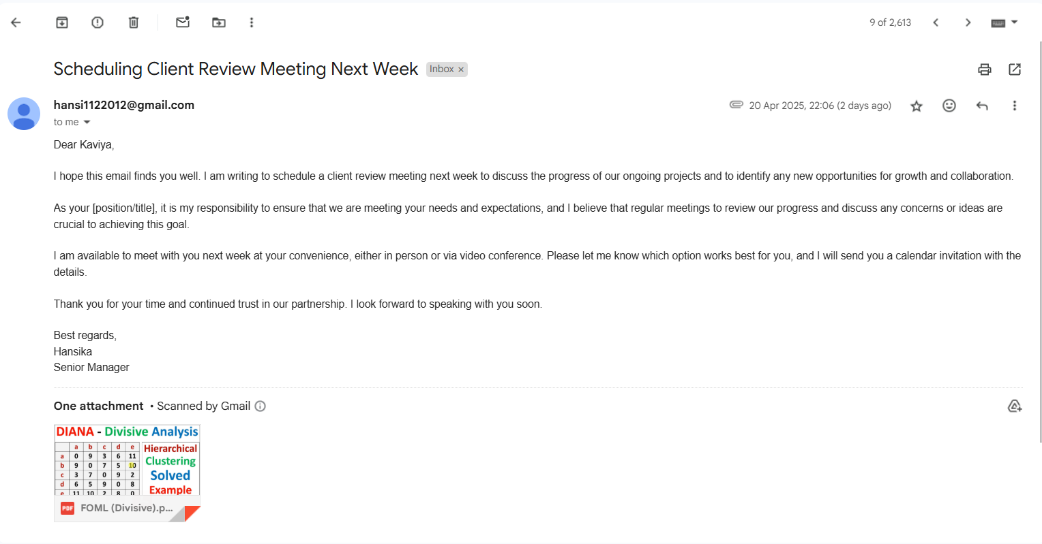
OUTPUTS

Slide 12
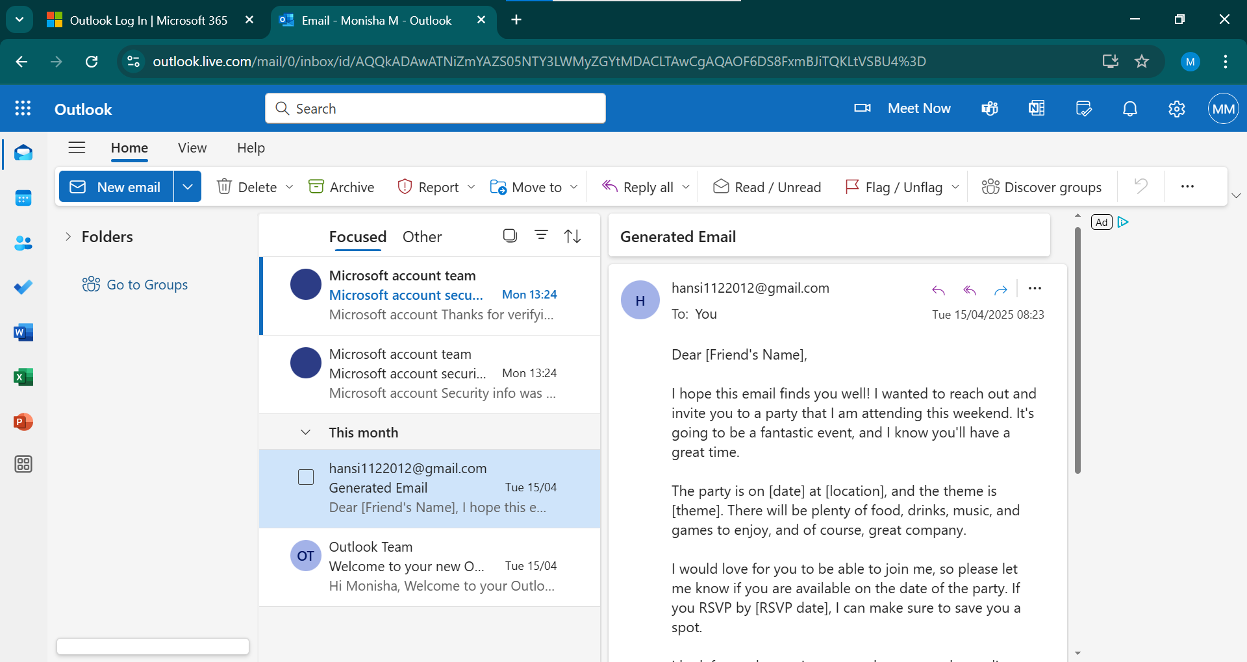
OUTPUTS

Slide 13
NOVELTY
AI Email Automation: Uses Mistral 7B Instruct for generating personalized email content, allowing real-time edits and seamless integration with email services.
Web Scraping: Extracts hyperlinks from websites or search queries, providing quick access to valuable data directly within the platform.
CSV Data Cleaning & Visualization: Allows users to clean and visualize CSV data by handling missing values and presenting insights via charts, streamlining data-related tasks.

Slide 14
SOCIAL RELEVANCE
TaskXpert addresses key challenges in digital communication and data management. By streamlining email composition with AI, it saves time and reduces the cognitive load for professionals, fostering more efficient communication.
The web scraping feature helps users quickly access relevant online information, improving research and decision-making processes.
Additionally, the CSV data cleaning and visualization tools make handling large datasets easier, aiding in data-driven decision-making.
Overall, TaskXpert enhances productivity, supports data privacy, and empowers users to manage communication and information more effectively in today's fast-paced digital world.

Slide 15
CONCLUSION
TaskXpert successfully integrates AI-powered email generation, smart data cleaning, and web scraping into one seamless platform, enhancing productivity and reducing manual effort. Its user-friendly design, secure processing, and modular architecture make it a reliable tool for professionals and students alike. The project demonstrates how intelligent automation can simplify complex workflows, offering a scalable foundation for future enhancements.

Slide 16
REFERENCES
[1]Loukili, Soumaya & Fennan, Abdelhadi & Lotfi, Elaachak. (2024). Email subjects generation with large language models: GPT-3.5, PaLM 2, and BERT. International Journal of Electrical and Computer Engineering (IJECE) , 2024.
[2]S. Bhosale, R. Dhumal, V. Patkar and T. P. Singh, "Use Of RPA For Email Automation With Salesforce Integration," 2023 IEEE 5th International Conference on Cybernetics, Cognition and Machine Learning Applications (ICCCMLA), Hamburg, Germany, 2023.
[3]G. Jagnade, S. Sable and M. Ikar, "Streamlining Email Workflow: Empowering Users with Voice Recognition Technology and Website-Email Autometa Solutions," 2023 14th International Conference on Computing Communication and Networking Technologies (ICCCNT), Delhi, India, 2023.
[4]S. Ghalme, K. Shelke, R. Kadam and U. Tupe, "Automated Emails and Data Segregation using Python," 2023 International Conference on Sustainable Computing and Smart Systems (ICSCSS), Coimbatore, India, 2023.
[5]M. N. Dandale, Mazharunnisa, D. J. J. D. Daniel, R. S. Priya, M. A. A. Walid and T. T, "Business Process Automation using Robotic Process Automation (RPA) and AI Algorithm’s on Various Tasks," 2023 8th International Conference on Communication and Electronics Systems (ICCES), Coimbatore, India, 2023.

Slide 17
REFERENCES
[6]C. Sathish, A. Mahesh, N. S. Karpagam, R. Vasugi, J. Indumathi and T. Kanchana, "Intelligent Email Automation Analysis Driving through Natural Language Processing (NLP)," 2023 Second International Conference on Electronics and Renewable Systems (ICEARS), Tuticorin, India, 2023.
[7]A. Khare, S. Singh, R. Mishra, S. Prakash and P. Dixit, "E-Mail Assistant – Automation of E-Mail Handling and Management using Robotic Process Automation," 2022 International Conference on Decision Aid Sciences and Applications (DASA), Chiangrai, Thailand, 2022 .
[8]Jonas Thiergart, Stefan Huber, Thomas Übellacker, “Understanding Emails and Drafting Responses -- An Approach Using GPT-3”, 2021 .
[9]S. Manikantam, P. Akhil, K. R. A. Reddy, G. S. P. Reddy, S. Hariharan and V. Kekreja, "Enhanced automated web scraping tool with proliferation of AI techniques," 2024 International Conference on Innovations and Challenges in Emerging Technologies (ICICET), Nagpur, India, 2024 .
[10]A. Abodayeh, R. Hejazi, W. Najjar, L. Shihadeh and R. Latif, "Web Scraping for Data Analytics: A BeautifulSoup Implementation," 2023 Sixth International Conference of Women in Data Science at Prince Sultan University (WiDS PSU), Riyadh, Saudi Arabia, 2023

Slide 18
THANK YOU

